Slide 1
The Exact Sciences in Antiquity

Slide 2
Science and Democratic government
We tend to assume that science and democracy are natural allies – that science encourages and supports democratic values and institutions and, in turn, democratic values (esp. respect for autonomy), if not a necessity, encourages the flourishing of scientific values and institutions.
The Greek city states were democratic in some sense of what we now mean by the term democratic. All citizens were encouraged to participate fully in intellectual life and the writings of the Greek authors tends to run across a number of subject, all at the same time.
Under the dictatorship of Alexander, which created a firm separation between political and ethical questions, on one hand, and questions about the world around us (nature), a different sort of science emerged, something we now call an exact science. An exact science is a science that is geared toward measurements carried it with instruments (hence = exact). Alexandrian science was geared towards quantitative analysis.

Slide 3
Theory vs quantitative analysis
When we think about science, we tend to think in terms of grand theories – Newton, Lavoisier, Maxwell, Darwin, Einstein.
One reason for this is a view about the aim of science, viz. science aims to give us true representations (theories) of the world around us. Our histories tend to highlight the emergence of these great theories, and by and large are insensitive to the importance of quantitative analysis (measurement) and the role that technology has played in the growth of scientific knowledge.
This view about the aim of science influences and shapes our beliefs and the comparative importance we place on the development of instrumentation, devices, equipment, experimentation, on one hand, and on the production of theory, on the other.
We tend to assume that theories always appear first in the order of things, and then scientists consult nature in the form of observation and experiment to asses whether these theories are well-founded. On this view, science is the product of homo sapien (thinking) and not homo faber (making).

Slide 4

The Character of Alexandrian Science
Euclid. The Elements. Systematic presentation of geometrical knowledge based on the method of postulation. Start with axioms (statements that are self-evidently true, such as “a line if the shortest distance between two points”), then move onto postulate (statements that are accepted without proof. Euclid accepts the following as postulates:
All right angles are equal to one another.
only one line can be drawn through a given point so that the line is parallel to a given line that does not contain the point.
Finally, deduce a series of theorems.

Slide 5
Euclid’s influence
The method of postulation has exerted an enormous influence on a number of fields but especially theoretical physics. Isaac Newton’s monumental Mathematical Principles of Natural Philosophy (16787) is written in the style of Euclid.
Postulation is ONE of the forms of styles of reasoning that are characteristic of the natural sciences: postulation, analogy (analogous models), statistical inferences, evolutionary histories, experimentation. Theories tend to have a shelf life, but the styles of reasoning have an enduring character.
These styles allow scientists to ask specific kinds of questions that they could not ask otherwise. They do not determine whether these questions are true or not.

Slide 6
Archimedes, Apollonius, Aristarchus
All made important contributions, especially to the science of mechanics (the pulley, gear, etc.).
Aristarchus, in particular, is remembered for his suggestion that the Sun is situated at the center of the planetary system and that the Earth rotates on an axis. We know nothing about the thinking that informed this conjecture, only that it was rejected out of hand by his successors in Alexandria.
When Copernicus was a young man (27), he travelled to Italy and spent 3 years in Bologna, mostly studying works in the humanities by Greek (and Alexandrian authors). He was well-acquainted with Aristarchus’ work. When he left Italy in 1501, he had the idea for his new astronomy.

Slide 7
The Ptolemaic System
Ptolemy’s great work, The Almagest, was completed in ca. 150 AD, translated into Arabic in 950 AD and then into Latin ca. 1460 AD.
It was the most influential astronomical theory in the West until the mid-1600’s when it was gradually supplanted, first, by the Copernican system and, second, by the Copernican system as modified by Newton.

Slide 8
Saving the Appearances
Ptolemy takes the task of astronomy to be that of explaining the apparently irregular movements of the heavenly bodies in terms of combinations of uniform circular motions.
The Ptolemaic system is more a mathematical device for computing the motions of planets than any cosmological device for the explanation of the universe. Furthermore, the mathem­atical arrangement is designed to bring order into the movements of the stars and planets as seen from the earth. This, a geocentric scheme, seemed the most logical.
his system must be understood as referring only to the angles at which planets are observed; that is to say, to their angular motion as seen projected against the background of the fixed stars. Hence, the theory ‘saves the appearance’ rather than attempts to give a picture of the orbit in space of any one planet. The path of the planet was a purely geometrical device to express the mathematical analysis, since algebraic methods were still far too crude for the purposes.

Slide 9
Geometrical Devices
Eccentric. The planets seem to approach and then recede from the Earth. Postulate that the Earth is not at the center of the cosmos but slightly off center. This point, or the eccentric, is the center of motion, and not the Earth. This strategy enabled Ptolemy to hold that the planets do not move uniformly with respect to the fixed stars as seen from the Earth, even though its motion in a circle is in fact uniform. If the planetary system is an eccentric system, rather than a homocentric system, there will be times when the Sun or planet will be very near the Earth (perigee) and times when it is very far from the Earth (apogee). Thus, we should expect a variation in the brightness of the planets.

Slide 10
Epicycle on Deferent Construction
The mathematical mechanism for the planets consists of a small circle, the epicycle, which rotates uniformly about a point on the circumference of a second rotating circle, the deferent. The planet, P, is located on an epicycle and the center of the deferent coincides with the center of the Earth. The curve resulting from the combination of epicycle and deferent is consistent with retrogradation.
We can add as many epicycles as are needed to get the planet at the right place at the right time.
With this device, we can generate almost any orbital shape.

Slide 11
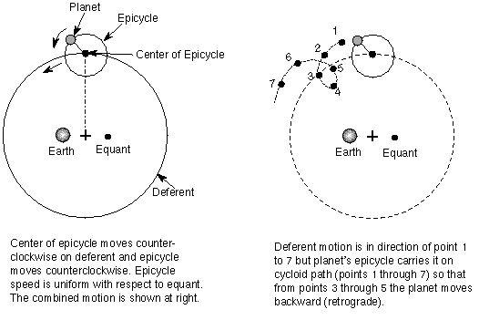
Ptolemy’s Epicycle on Deferent Construction

Slide 12
The Equant
In order to bring his planetary models in line with observations of the positions of the planets, Ptolemy has the planets speeding up and slowing down as they move along the epicycle.
We may be uncomfortable with the suggestion, defenders of Ptolemy would argue, that the planets can actually speed up and slow down in their orbits. Imagine, though, that you are an angel. As an angel, you would be able find a place where you could enjoy the planet moving uniformly around you. That place is the equant. In effect, what this argument is asserting is that there is a place in our mind where a planet can be seen not to be violating Aristotle’s teachings.

Slide 13
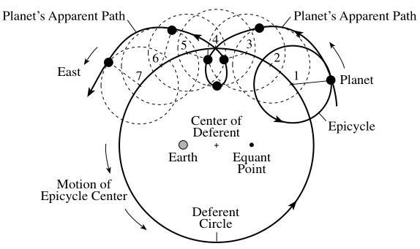
Retrograde Motion

Slide 14
Issues for the Ptolemaic Planetary Theory
Abandons egocentricity, but holds onto geostaticity. A point in empty space (i.e., a mathematical point is the reference for planetary motion). The Earth is no longer at the center, which clashes with Aristotle’s physics.
Gives up uniform (perfect motion). The target of Copernicus’ rejection of the Ptolemaic system is the equant, which , in hindsight seems like a very conservative reaction, not the revolutionary one we would expect.

